Slide 1
Couchbase Mobile PouchDB Workshop
Nic Raboy, Developer Advocate at Couchbase

Slide 2
The Plan
Where are things headed
The business problem
Couchbase Mobile
Example native code
Example hybrid code

Slide 3
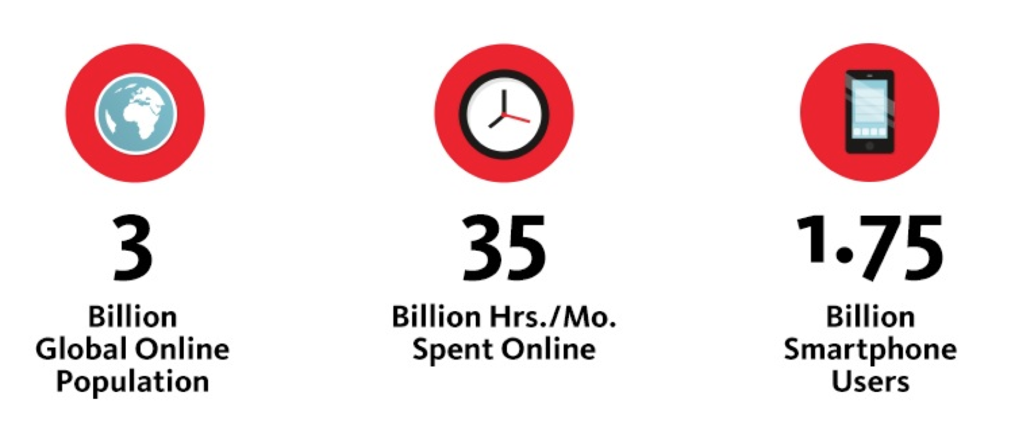
Current State

Slide 4
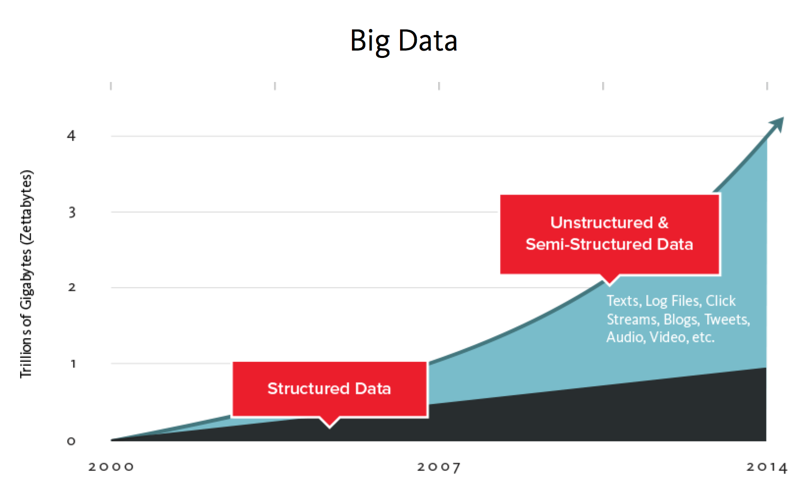
Trends

Slide 5
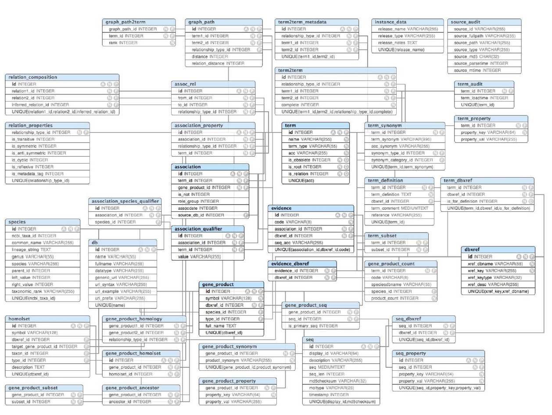
RDBMS

Slide 6
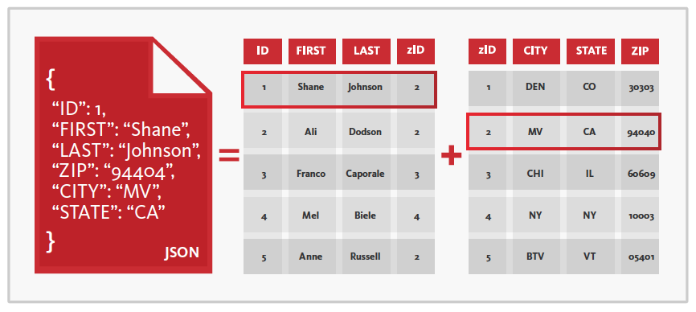
NoSQL

Slide 7
What is the business problem?
Notes:
Before we begin, I want to take some time to share with you why we created Couchbase mobile, and the business problem that we hoped to solve.

Slide 8

Today’s Mobile Apps
No Internet
Try again later.
please wait…
Notes:
Today’s Mobile Apps
----
Most of today’s mobile apps are designed so that any remote data, whether downloading records from a server or uploading your local data, requires the network to be available and online.
As long as that’s the case, and the Internet connection is fast enough, and there aren’t any problems, then the app performs exactly as expected—and that’s great.
But as soon as the network begins to degrade, say we’re down to just a couple of tower bars, or the Wi-F is having a bunch of latency—that sort of thing—then we start to see the app’s user experience break down. That’s when we see the progress notification UI hints show up, the spinners, the waiting.
If things get bad enough, we will see an error message saying that, “I’m sorry you can’t do what you were trying to do right now, you’ll have to try later.” Whatever work you were doing is lost, and the end result is a user who is unhappy and dissatisfied and can use your app.

Slide 9
How Does This Affect What People Think?
Doesn’t work a lot of the time and when it does it’s slow.
Notes:
How Does This Affect What People Think?
----
how do you know if you’ve got these kind of problems?
Well, it’s reflected in your app store rating. We’ve all seen apps in the one and two star category, with user reviews saying that the app doesn’t work or it’s slow.

Slide 10
How Does This Affect App Uninstall Rates?
Source: uSamp
Notes:
How Does This Affect App Uninstall Rates
----
Besides the bad brand PR, why should you care? Because people delete poorly performing apps.
Let’s look at application uninstall rates. Why do people delete an app from their device?
The top three reasons are: freezing, crashing, and slow responsiveness.
And in the case of freezing and slow responsiveness, those are directly tied to how we build our application. More often than not, our networking code is the culprit. In a lot of cases we can’t control the environment where people are using our app, but if we’re using proper coding strategies, we can mitigate those issues.

Slide 11
Data Location is the Problem
Notes:
Slide 10 - Data Location is the Problem

Slide 12
Local Data + Sync is the Solution
Notes:
Slide 11 - Local Data + Sync is the Solution

Slide 13
What Does This Mean For Your Apps
Always work both online & offline
Always be blazing fast
Built with orders of magnitude less code
Users will absolutely love your apps

Slide 14
What is Couchbase Mobile?

Slide 15
Couchbase Lite
Sync Gateway
Notes:
We have two core products in Couchbase mobile.
We have Couchbase Lite, which runs on the device
And we have Sync Gateway, which stands on the border between your private cloud and the public cloud.

Slide 16
Couchbase Lite
Some Highlights
NoSQL Mobile Database
Document Oriented & Schema-Less
Small Footprint (~400kb)
Runs In-Process
Notes:
We have two core products in Couchbase mobile.
We have Couchbase Lite, which runs on the device
And we have Sync Gateway, which stands on the border between your private cloud and the public cloud.

Slide 17
Couchbase Lite
Document-Oriented Database
Key-value collections with versioning
Schema-less
Code fast, run fast
Notes:
We have two core products in Couchbase mobile.
We have Couchbase Lite, which runs on the device
And we have Sync Gateway, which stands on the border between your private cloud and the public cloud.

Slide 18
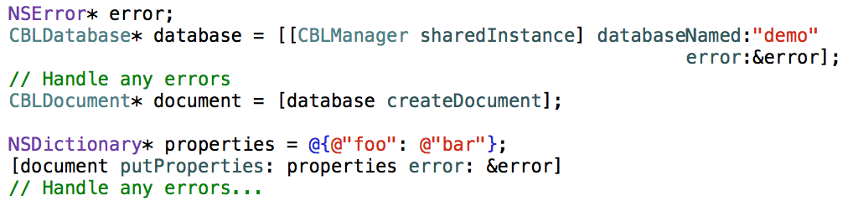
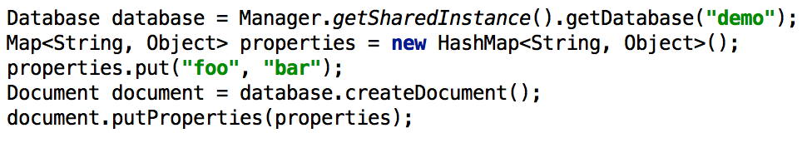
Notes:
Here are code snippets that show what it takes to get a handle to a database object in Couchbase Lite and how to create a brand new document.
The top code block is in Objective-C, the bottom is in Java. In both cases we have a manager class which we use to provide us with instances of database objects. In both cases, I’m asking for a database named demo. In both cases I’m using a get or create semantic, so I know that my database variable will never be nil in these cases. If this is the first time I’ve run this code block, then it will create the demo database for me. If I’ve run it before, it will just reopen the existing database on disk.
Once we have the database handle, all we need to do is create a new document. Which until we call the putProperties method down below, It will not actually be saved yet. We create the new, unsaved document, then we need to have a key value pair collection to pass in to it.
On the top block, I have the properties NSDictionary, which just have a simple “foo” key with a “bar” value. Same thing with my hash map down in Java. And then I call the putProperties method, which is effectively is the save method for a document. That will insert the properties as the content for that document and create a new revision.

Slide 19
{
"session": {
"Id": "session-1011",
"Location": "TBA",
"SpeakerIds": [
"speaker-nic-raboy"
],
"Time": "2014-10-06T15:20:00",
"Title": "Building the Mobile Apps with Couchbase Mobile",
"Track": "Mobile"
},
"type": "session"
}
Notes:
This is a record taken from our conference app this year using Couchbase mobile. This is a session record pulled directly out of Couchbase Server, which is the back end that we use for Sync Gateway. In this case, it’s very straight forward JSON with a nested object graph, so if I need to work with this data it’s just as simple as using normal key-value pair collections that I’m already using in my applications.

Slide 20
Couchbase Lite
MapReduce Views
Build indexes in your native language
Set break points to debug
Notes:
We have two core products in Couchbase mobile.
We have Couchbase Lite, which runs on the device
And we have Sync Gateway, which stands on the border between your private cloud and the public cloud.

Slide 21
Map / Reduce Views
Concept from functional programming, via Google
App-defined map function operates on documents
Function output generates an index ordered by key
Index rows can be aggregated via a reduce function
Index is queried by a key or key range

Slide 22
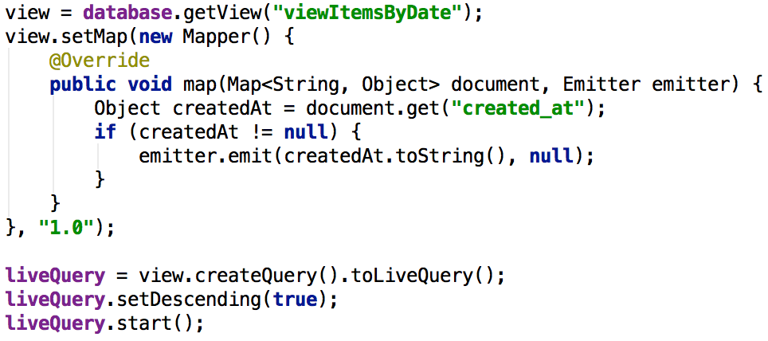
Notes:
So here’s in example in Java in this case, continuing where we left off, we are going to create a view, which is our name for an index in Couchbase lite. In this case, I am creating a view, called “viewItemsByDate” and again, I’m following that same get or create semantics here. I’m providing a map function here, and the map function receives a Java map object and it also is given a callback object, as a delegate.
So I can do some basic things, where I can verify that the incoming document has a key called “create_at” which I would have created in my application code elsewhere, and that if it’s not there, then we’re not actually going to index this document. But if it is there, I’m going to call the emit function back, to insert a key-value pair into the dictionary. In this case, I’m only setting a value for the key, which is the actual time stamp itself as a string, and I don’t actually need to provide a value, so I pass null.
In my case, I just want to do a simple ordering based on creation time stamp, and passing null lets me save a little space on disk.
Finally, once I’ve got my view created, all I need to do to get a query object is call “createquery”. The query let’s us set some things, like we can filter by ranges, we can also set the sort order, and you’ll notice here I’m doing something called a “livequery” which we will talk about in a second when we talk about event notifications.
But a live query lets us effectively create a never ending query, so that whenever results are return, whether it’s going through results already on disk, or later on as new records are inserted into the database, the same logic will get called back so I can handle any future changes to the data, the same way I would handle the initial query.
It is a very powerful change in how we build applications, and it reduces the amount of cruft code that we write.

Slide 23
Couchbase Lite
Change Notifications
Listen / observe for changes
Databases, queries, documents
Cuts down on a ton of cruft code
Notes:
We have two core products in Couchbase mobile.
We have Couchbase Lite, which runs on the device
And we have Sync Gateway, which stands on the border between your private cloud and the public cloud.

Slide 24
Story Time
NoSQL vs SQLite

Slide 25
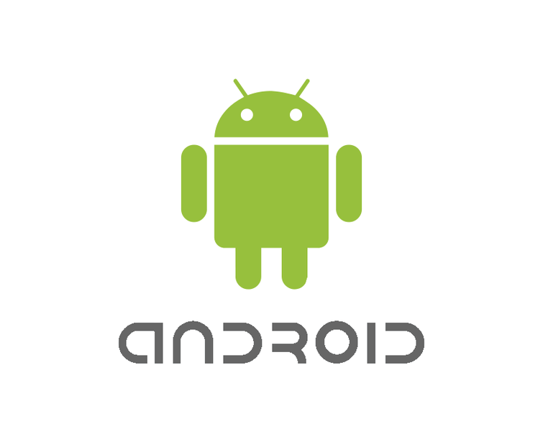
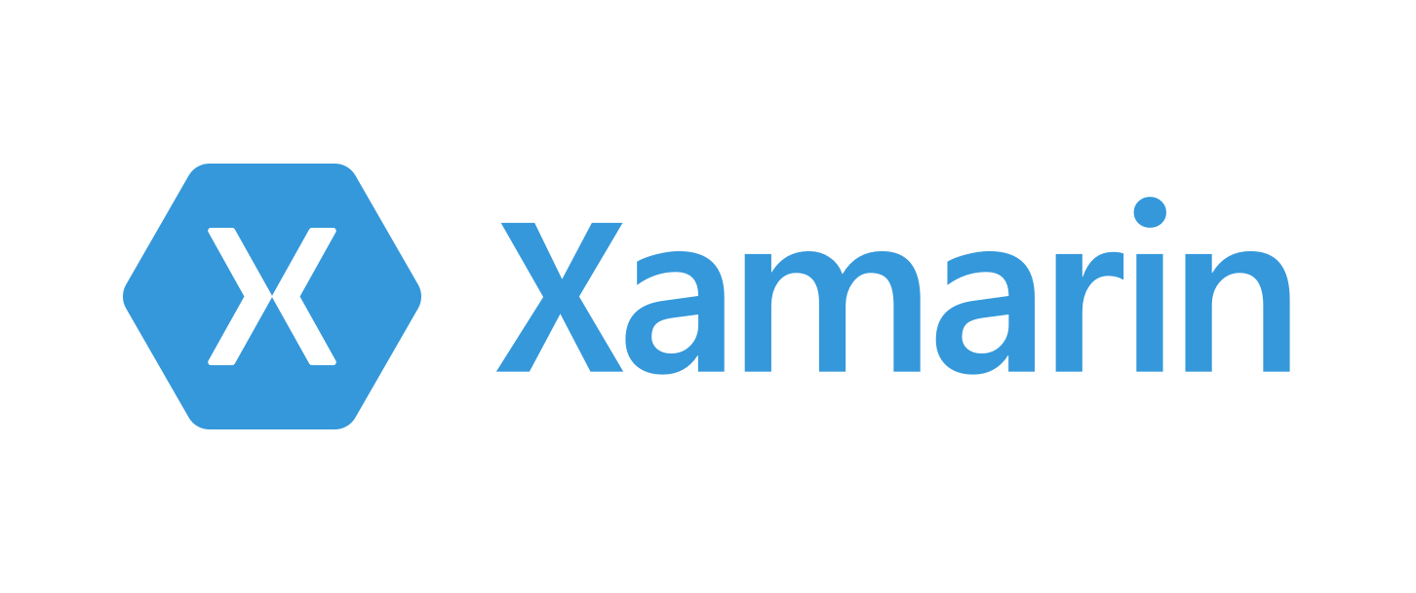

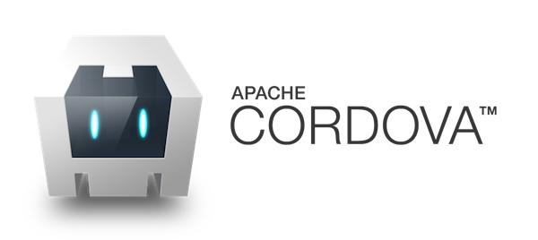
Available SDKs & Frameworks

Slide 26
Couchbase Sync Gateway
Some Highlights
Data Replication Between Server & Device
Data Orchestration
Authentication & Authorization

Slide 27
Couchbase Sync Gateway
Syncing
Full Multi-master replication
Continuous or ad-hoc replication in either direction
Change notifications and conflict detection

Slide 28
Replication
Is asynchronous
Can be continuous or one-shot
Sends JSON over HTTP
Handles network hiccups
Network timeouts

Slide 29
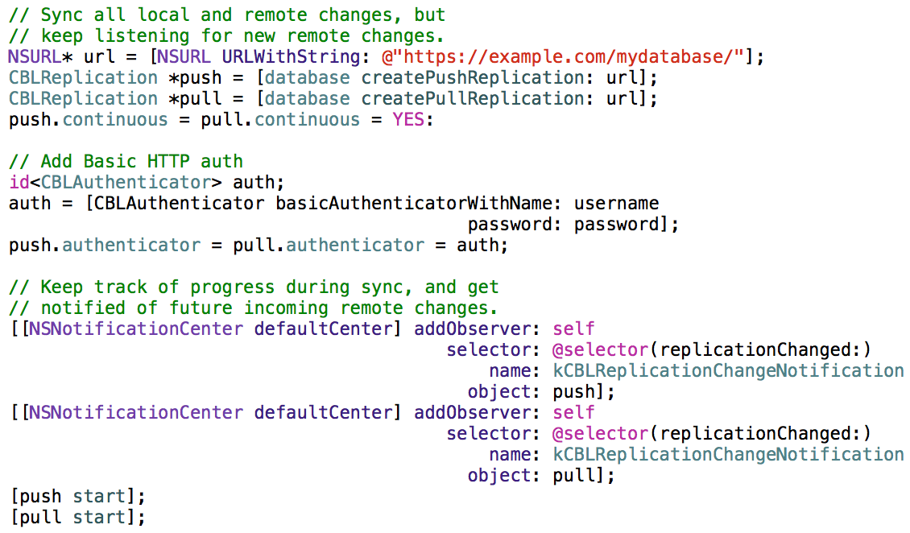
Notes:
Here’s a complete comprehensive example of what it takes to start up a continuous, bi-direction sync session, in iOS in this case, where I’m even throwing in subscribing to change notifications, and I’m also adding in authentication. In this case, basic http authentication.
So this is, in 99% of use cases, the most code you would ever have to write in your application to sync enable it, this is very powerful. At the minimum, only the first three lines and the last two lines, would be required.
It’s a very powerful way to program. If you’re building locally, you’re also effectively building remotely as well.

Slide 30
Notes:
Sync gateway also handles the permanent persistence of your applications data in your Couchbase Server cluster that lives in your private data center. So as your device is syncing with sync gateway and pushing your data up, sync gateway is also writing that data into the permanent data store, backed by our highly scalable Couchbase Server technology.
Now, let’s look at security layer concerns: in this particular case, authorization.

Slide 31
Story Time
Creating Something that Syncs

Slide 32
Couchbase Sync Gateway
Authorization in Sync
requireUser (username)
requireRole (rolename)
requireAccess (channel)

Slide 33
Couchbase Sync Gateway
Authorization in Sync
channel (name)
access (username, channelname)
role (username, rolename)

Slide 34
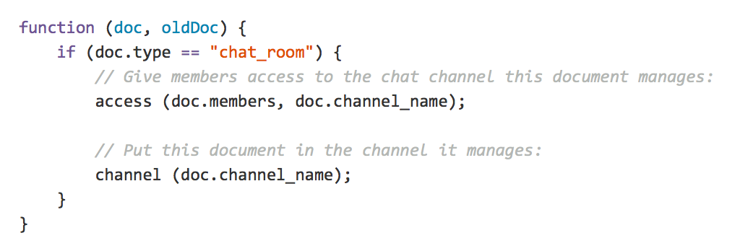
Notes:
Here is a very simple example of what a sync function looks like. In this, I’m only dealing with a specific type of document, called “chatroom”. Type is simply a key that I defined in my document when I saved it, in this case, I’m looking at “chatroom” as the value.
For any document that represents a chatroom object, I can grant access to anybody that’s in the members array that I included in my document, and I can even let my document store channel name key-value pairs, so that anyone in that channel can have access as well.
Finally, I put this document in the channel, so that it shows up to those users with access.

Slide 35
Channels
Nature
Admin
Sports
San Francisco

Slide 36
Couchbase Mobile Summary
Offline first approach
NoSQL document database
Works with Couchbase Server
Available for many platforms and frameworks
Makes life easy for you (the developer)

Slide 37
Own Your Data

Slide 38
Software vs Service
PayPal’s StackMob
Dropbox’s Datastore API
Facebook’s Parse

Slide 39
Software on a Service
Amazon Web Services
Microsoft Azure
Docker
…

Slide 40
Couchbase Lite for Native Android & iOS

Slide 41
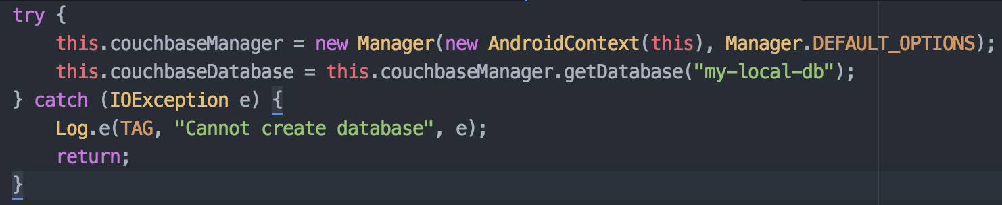
Creating a Database

Slide 42
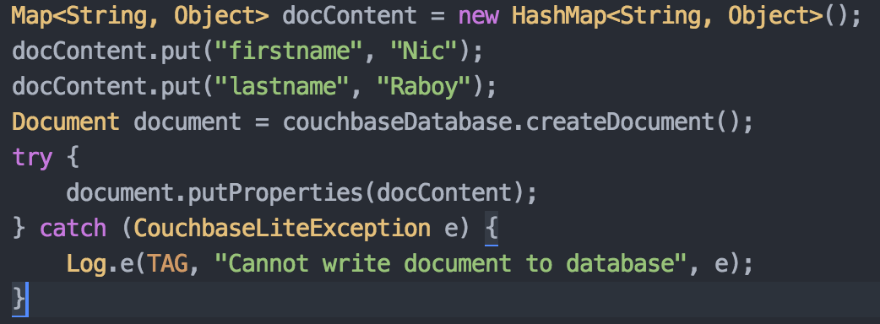
Inserting a Document

Slide 43
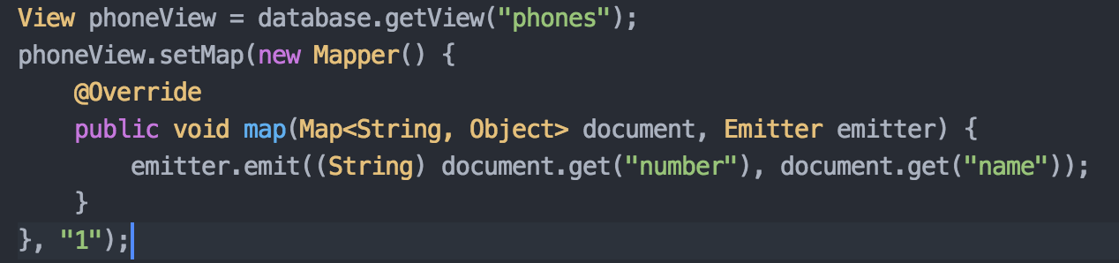
Couchbase Lite Views

Slide 44
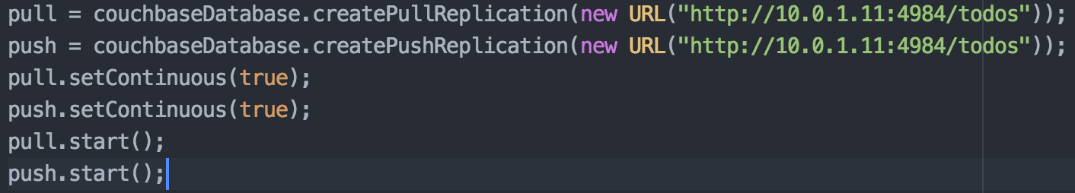
Replication With Sync Gateway

Slide 45
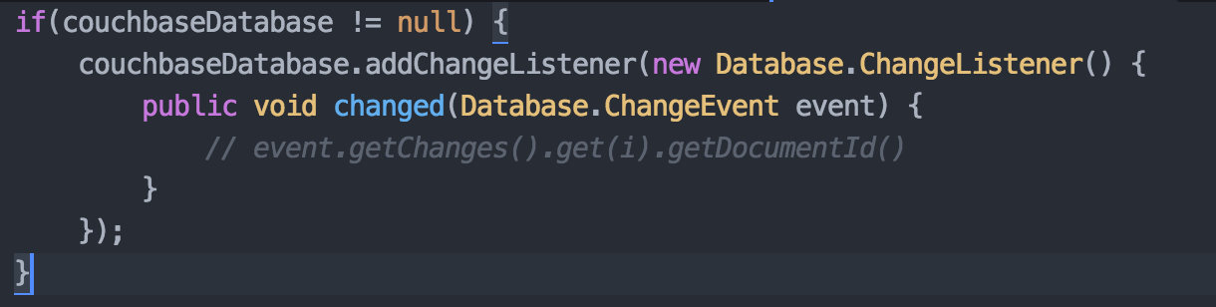
Listen For Changes

Slide 46
Other Ways To Listen
DatabaseChanged: Any document updated
DocumentChanged: A specific document updated
LiveQuery: Change in query result set

Slide 47
Couchbase Lite for Desktop
iOS SDK works for OS X desktop applications
Java SDK works for desktop applications

Slide 48
Couchbase Cordova Plugin

Slide 49
Couchbase Cordova Plugin
Compatible with Android and iOS
Access Couchbase Lite via RESTful APIs
Easily integrate with Ionic Framework and PhoneGap through the ng-couchbase-lite wrapper

Slide 50
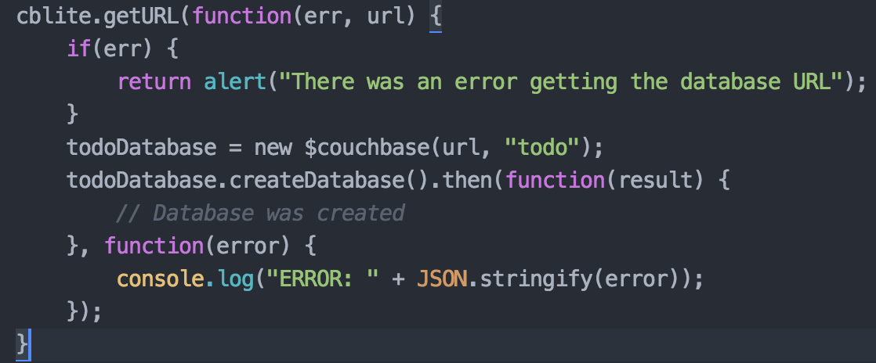
Creating a Database
Notes:
Creating a Database
----
cblite.getURL is the only available plugin function.
Use the URL to create a new ng-couchbase-lite object and assign it a database name. All requests will go against this URL and database including the “createDatabase” function.

Slide 51
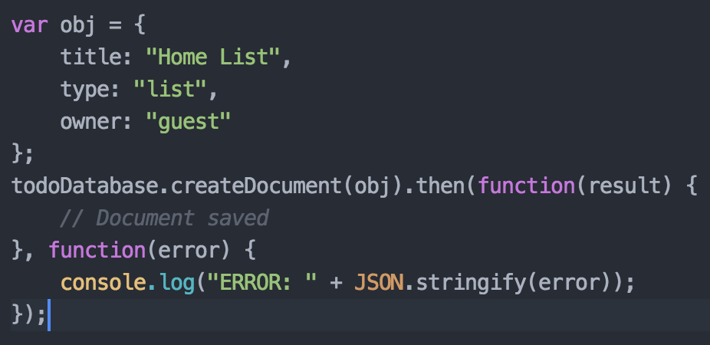
Inserting Documents
Notes:
Inserting Documents
----
Show that you can take a JavaScript object and insert it directly into Couchbase Lite without any further manipulations. Database transactions return promises to remain asynchronous.

Slide 52
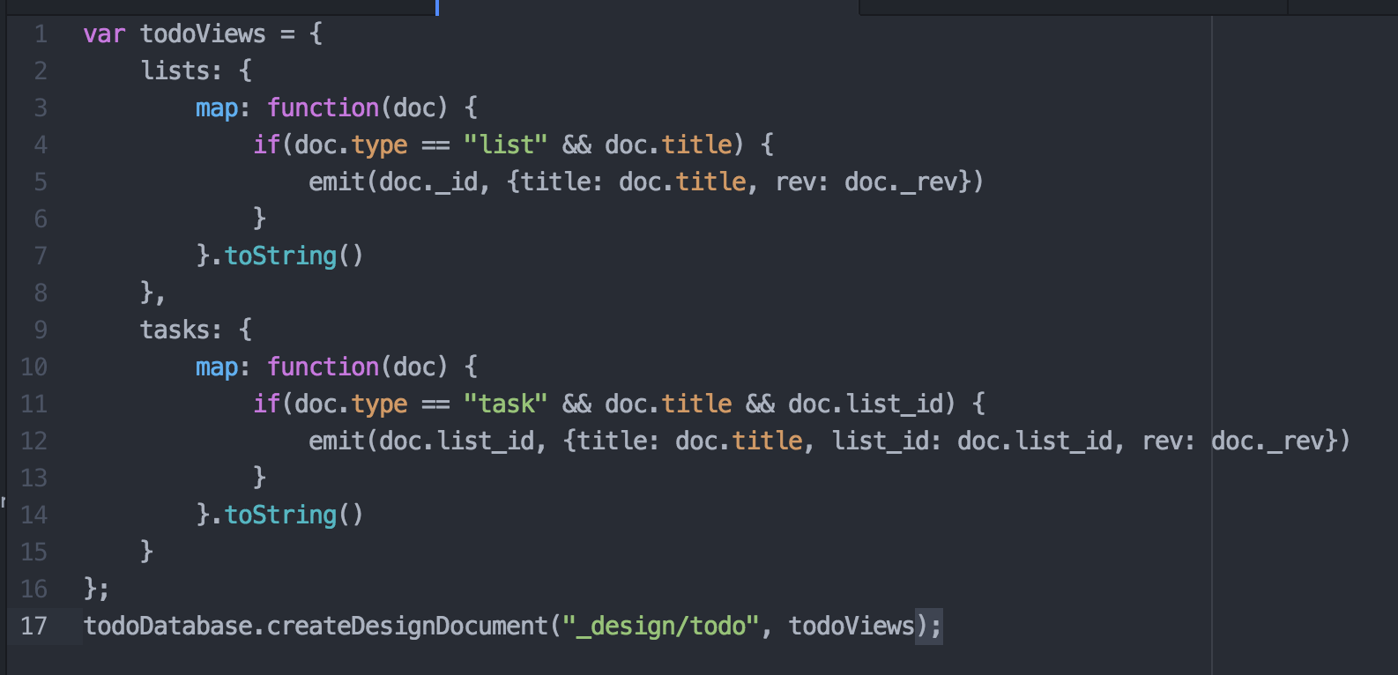
Couchbase Lite Views
Notes:
Couchbase Lite Views
----
Elaborate the differences between HTML5 local storage and NoSQL.
With HTML5 local storage you’re probably going to serialize all data into a single property. This single property is going to become quite large and hard to maintain, but you’re going to do your lookups with that one key name that you probably remember.
With NoSQL documents you’re going to have many documents which you probably won’t remember the key names for. To get all these documents you’re going to need to design a view for querying them. In the case of the Todo Lite example, there are two views. A view for querying lists and a view for querying the tasks that exist in a list.

Slide 53
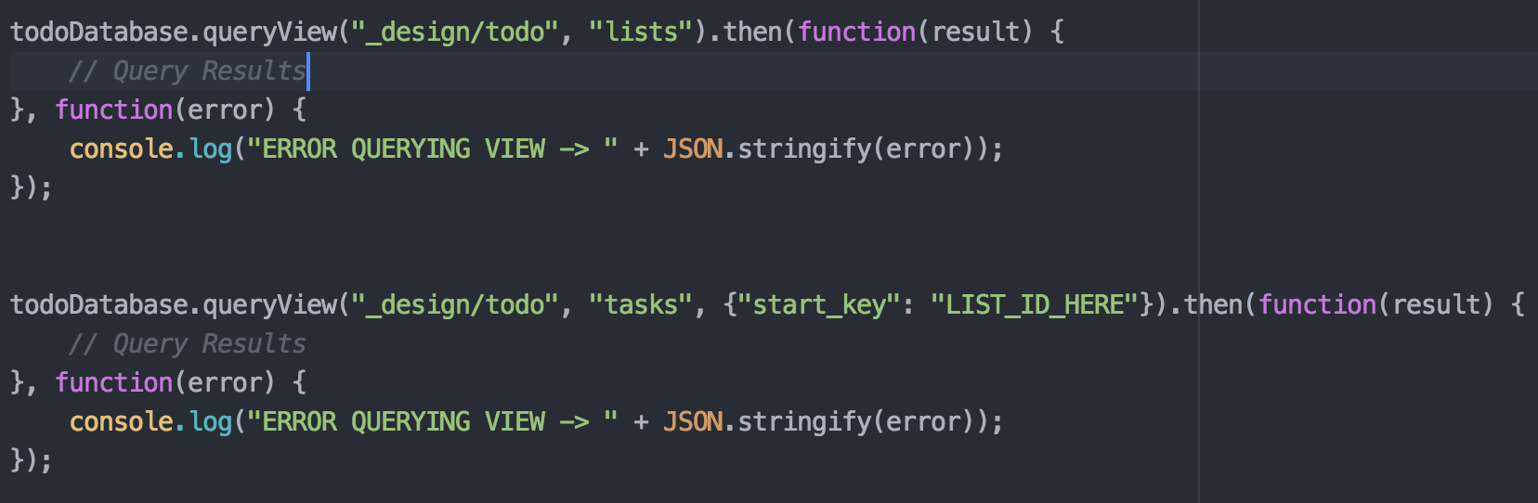
Querying Couchbase Views
Notes:
Querying Couchbase Views
----
Querying the “lists” view will return all lists, but of course in a promise to remain asynchronous. You also have the option to pass a start key, which is obvious in the example of querying the “tasks” view. You don’t want to query all the tasks, only the particular tasks that go with a list.

Slide 54
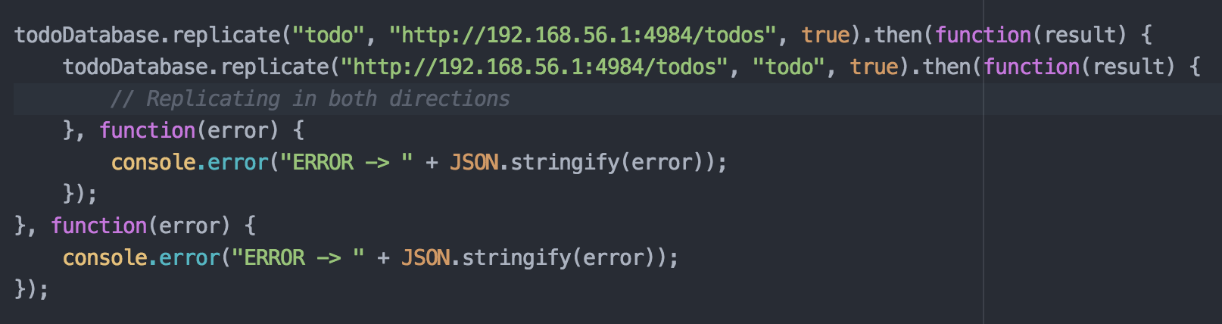
Replication With Sync Gateway
Notes:
Replication With Sync Gateway
----
When replication starts, it will asynchronously happen in the background. In this example, replication will continuously happen, pushing all local changes to the sync gateway. Once local starts replicating up, we also replicate the sync gateway down to local. We are starting two replication processes.

Slide 55
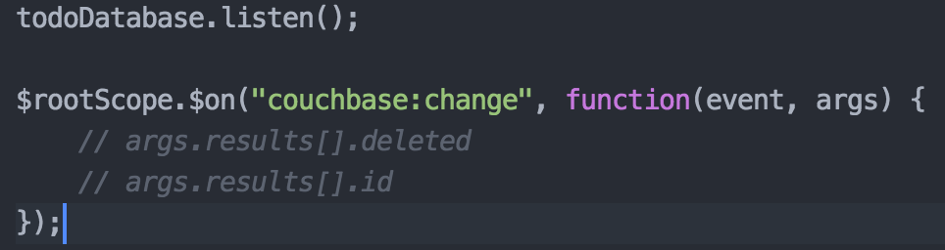
Listen for Changes
Notes:
Listen for Changes
----
The “listen()” function of ng-couchbase-lite will broadcast any changes it picks up by doing continuous long-polls against the API. Changes include those done locally and remotely. Anything broadcasted can be picked up in AngularJS with the “$on” method of “$rootScope”.
Broadcasted information is in array form with properties that contain ID and “possibly” a deleted property to signify that a document has been deleted

Slide 56
Community Created PouchDB Library

Slide 57
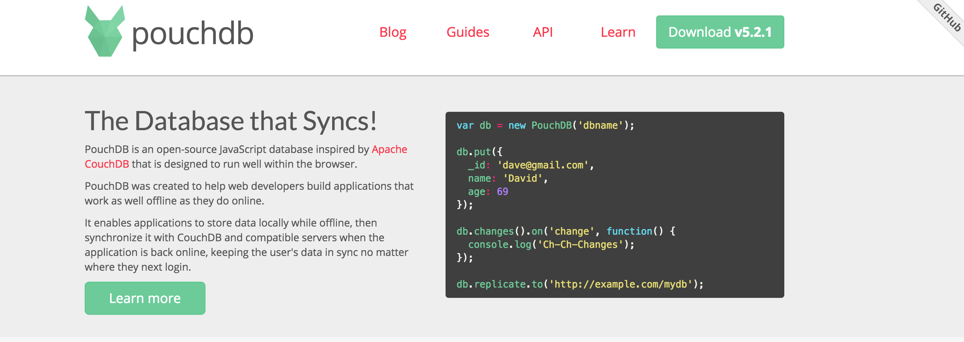
PouchDB
Notes:
Listen for Changes
----
The “listen()” function of ng-couchbase-lite will broadcast any changes it picks up by doing continuous long-polls against the API. Changes include those done locally and remotely. Anything broadcasted can be picked up in AngularJS with the “$on” method of “$rootScope”.
Broadcasted information is in array form with properties that contain ID and “possibly” a deleted property to signify that a document has been deleted

Slide 58
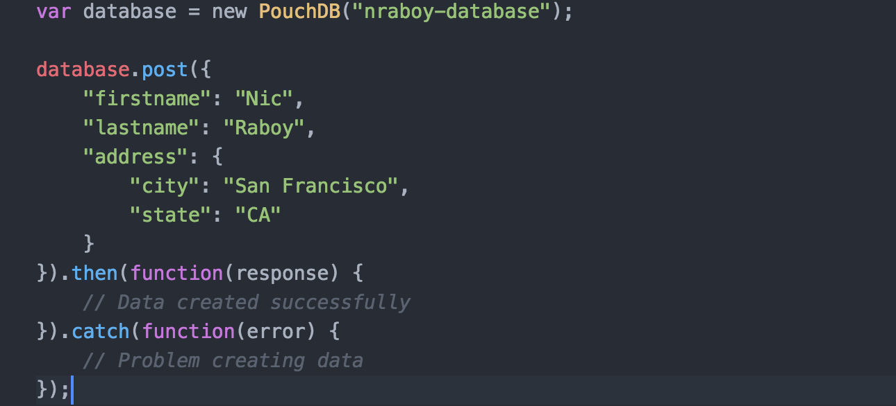
Creating a Database and Data
Notes:
Creating a Database
----
cblite.getURL is the only available plugin function.
Use the URL to create a new ng-couchbase-lite object and assign it a database name. All requests will go against this URL and database including the “createDatabase” function.

Slide 59
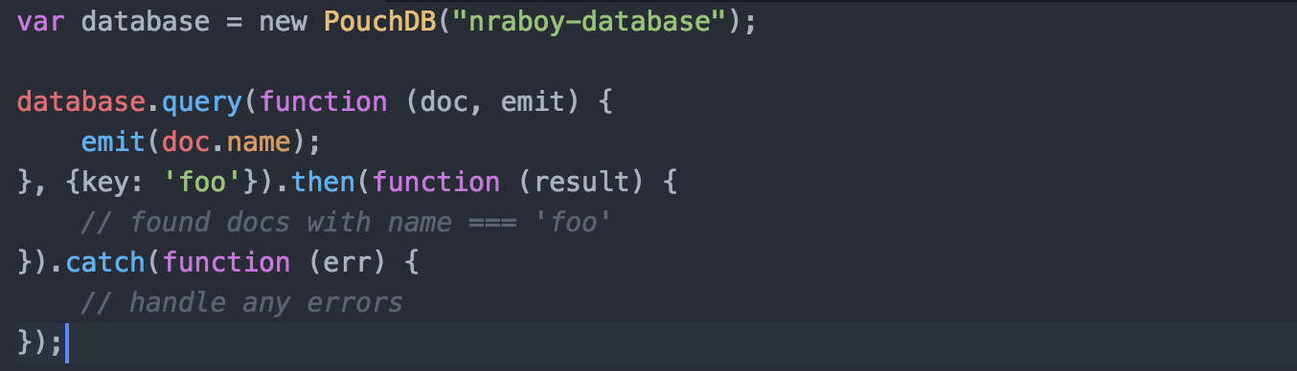
PouchDB Queries
Notes:
Couchbase Lite Views
----
Elaborate the differences between HTML5 local storage and NoSQL.
With HTML5 local storage you’re probably going to serialize all data into a single property. This single property is going to become quite large and hard to maintain, but you’re going to do your lookups with that one key name that you probably remember.
With NoSQL documents you’re going to have many documents which you probably won’t remember the key names for. To get all these documents you’re going to need to design a view for querying them. In the case of the Todo Lite example, there are two views. A view for querying lists and a view for querying the tasks that exist in a list.

Slide 60
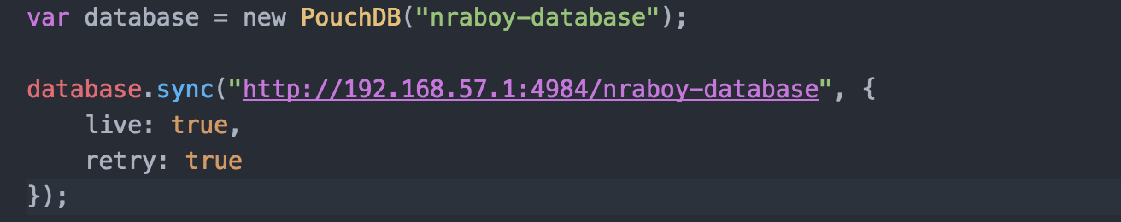
Replication With Sync Gateway
Notes:
Replication With Sync Gateway
----
When replication starts, it will asynchronously happen in the background. In this example, replication will continuously happen, pushing all local changes to the sync gateway. Once local starts replicating up, we also replicate the sync gateway down to local. We are starting two replication processes.

Slide 61
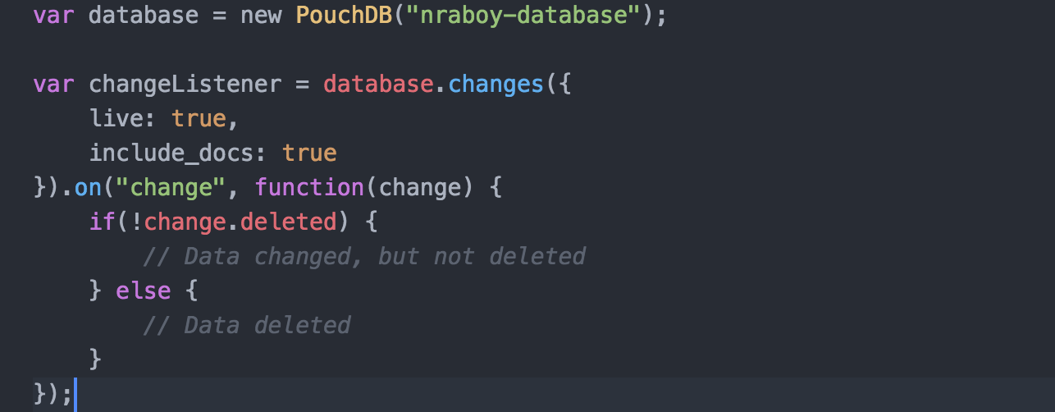
Listen for Changes
Notes:
Listen for Changes
----
The “listen()” function of ng-couchbase-lite will broadcast any changes it picks up by doing continuous long-polls against the API. Changes include those done locally and remotely. Anything broadcasted can be picked up in AngularJS with the “$on” method of “$rootScope”.
Broadcasted information is in array form with properties that contain ID and “possibly” a deleted property to signify that a document has been deleted

Slide 62
Couchbase Sync Gateway

Slide 63
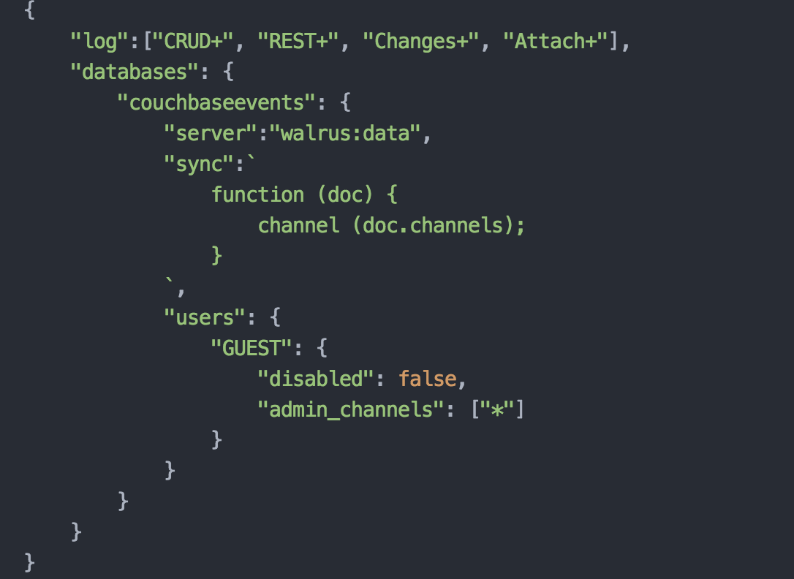
Basic Sync Gateway Configuration

Slide 64
Demo Time!

Slide 65
Couchbase Labs on GitHub
https://github.com/couchbaselabs/todolite-android
https://github.com/couchbaselabs/todolite-ios
https://github.com/couchbaselabs/todolite-ionic
Notes:
Couchbase Labs on GitHub
----
A fully functional example project is available for download on GitHub.

Slide 66
Questions?

Slide 67
Starting the PouchDB Workshop

Slide 68
Workshop Goals
Create a cross platform mobile web application with Ionic Framework that syncs
Create a new local database for Android and iOS
Learn how to do CRUD operations on local NoSQL data
Configure Couchbase Sync Gateway and Couchbase Server
Synchronize data between local device and Couchbase Server
Notes:
Couchbase Labs on GitHub
----
A fully functional example project is available for download on GitHub.

Slide 69
Workshop URL
https://github.com/couchbaselabs/couchbase-mobile-pouchdb-workshop
Notes:
Couchbase Labs on GitHub
----
A fully functional example project is available for download on GitHub.

Slide 70
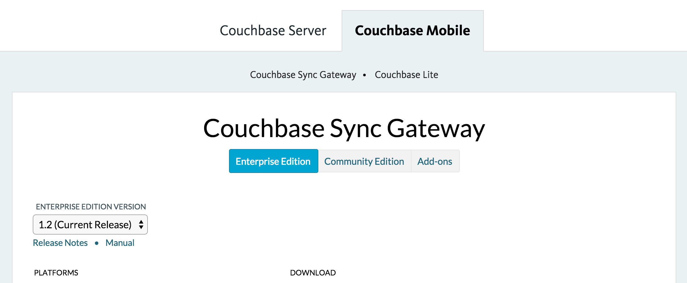
Download Couchbase Sync Gateway
http://www.couchbase.com/downloads
Notes:
Couchbase Labs on GitHub
----
A fully functional example project is available for download on GitHub.

Slide 71
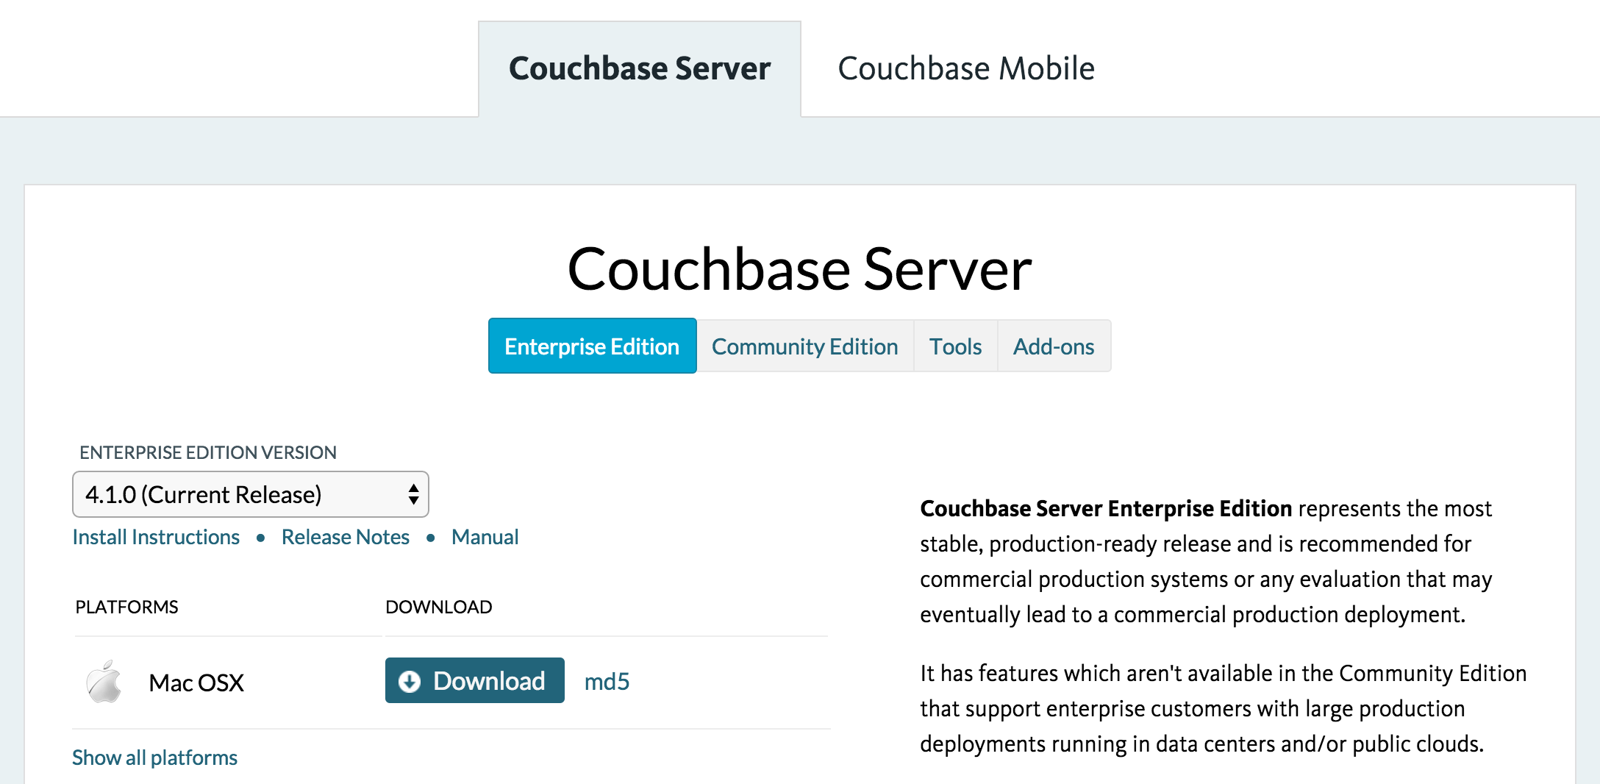
Download Couchbase Server
http://www.couchbase.com/downloads
Notes:
Couchbase Labs on GitHub
----
A fully functional example project is available for download on GitHub.

Slide 72
Testing Our Environment
Install Ionic Framework and Apache Cordova via NPM
npm install –g ionic cordova
Download or clone the workshop and navigate into the finished directory
Restore all platforms and plugins to the project
ionic state restore
Run or Android or iOS
ionic run [platform_here]
Notes:
Couchbase Labs on GitHub
----
A fully functional example project is available for download on GitHub.

